Slide 1
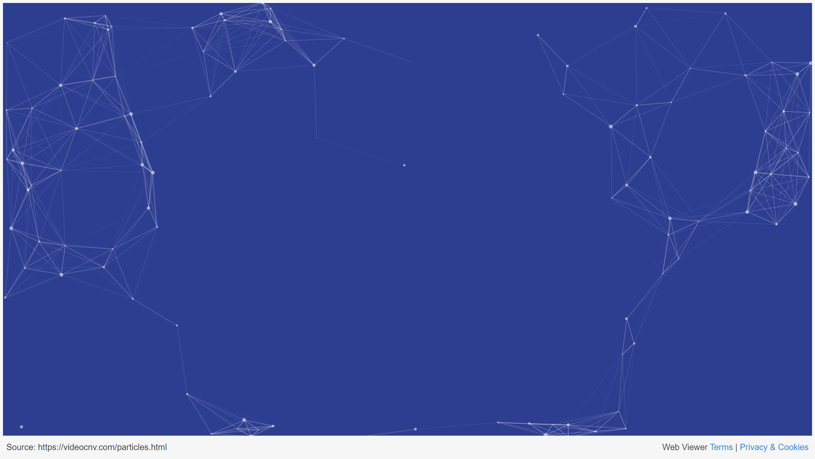
Logging and Exception Handling
Exceptions, Logging libraries, Log Type, Middlewares
Vanyo Vanev
Development Team Manager
04.11.2023

Slide 2
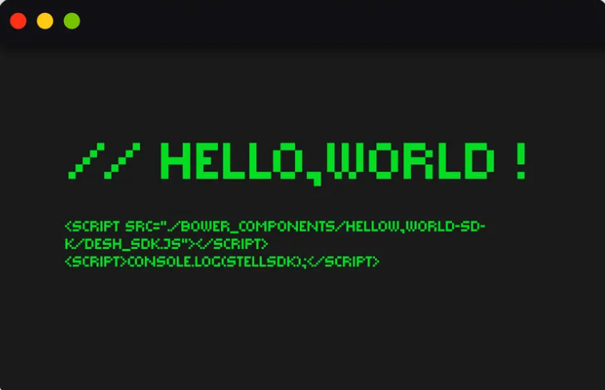
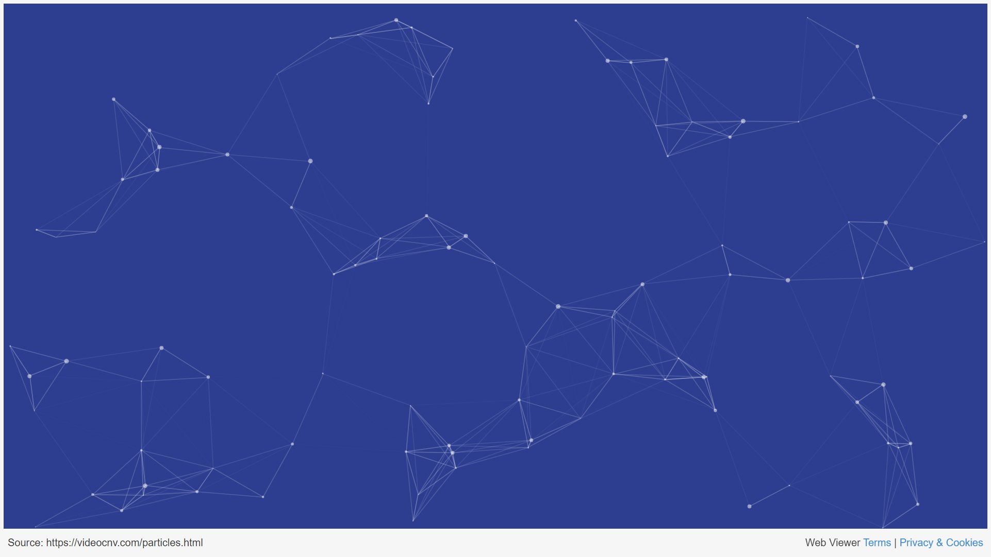
INTRODUCTION
- Logging and Exception Handling in C#
- Logging Libraries
- Types of Logging
- Middlewares
- Best Practices
- Q&A and Closing

Slide 3

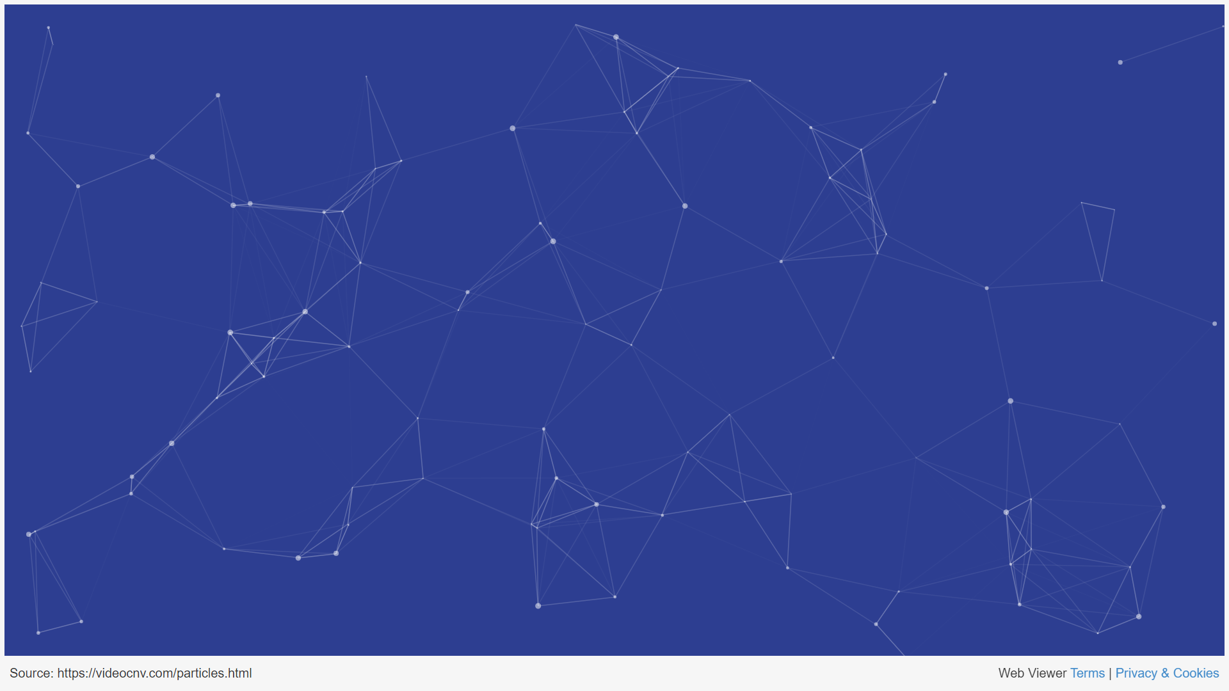
OBJECTIVES
- Overview of logging and exception handling in C# applications
- Popular logging libraries and their use cases
- Different types of logging and their advantages and disadvantages
- The concept of middlewares and their role in logging and exception handling
- Best practices for implementing logging and exception handling in .NET projects

Slide 4

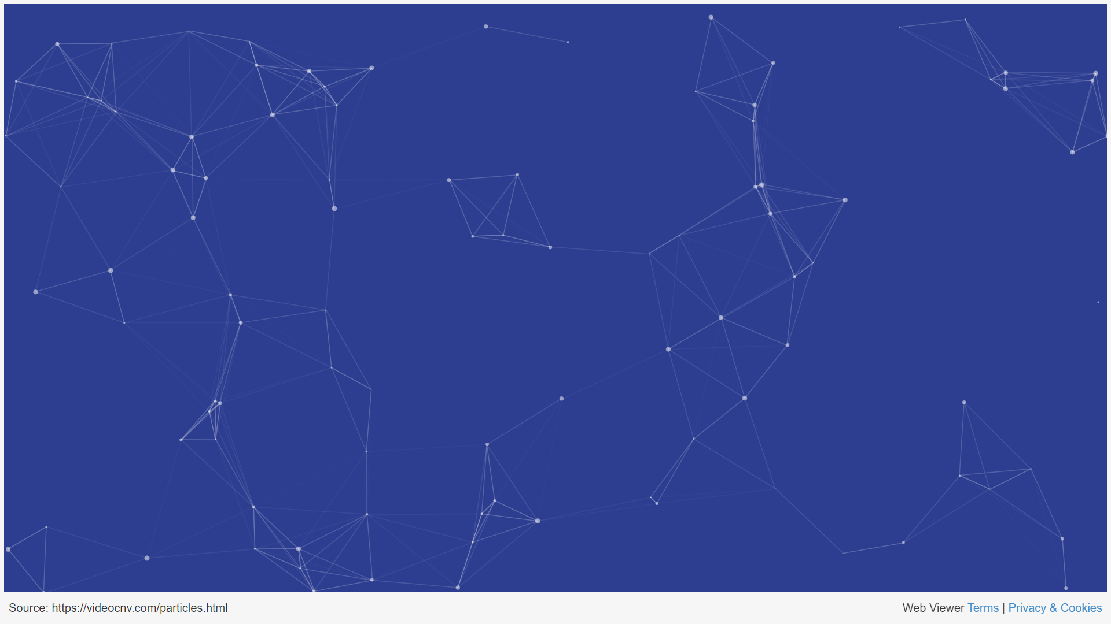
EXCEPTION HANDLING
- Preventing application crashes: Proper exception handling allows you to catch and manage exceptions, preventing unexpected application crashes.
- Graceful error recovery: rolling back transactions, releasing resources, or providing alternative execution paths
- Debugging and diagnostics: allows you to log and report errors that occur during the execution of your application
- User experience: used to provide meaningful error messages or feedback to users when something goes wrong
- Security: can help prevent security vulnerabilities by ensuring that sensitive information (e.g., stack traces) is not leaked to users or attackers when an error occurs

Slide 5
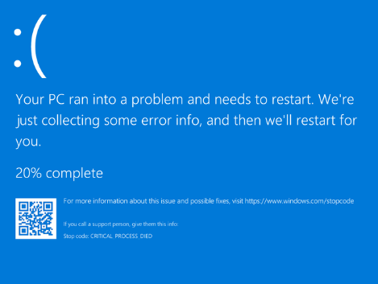
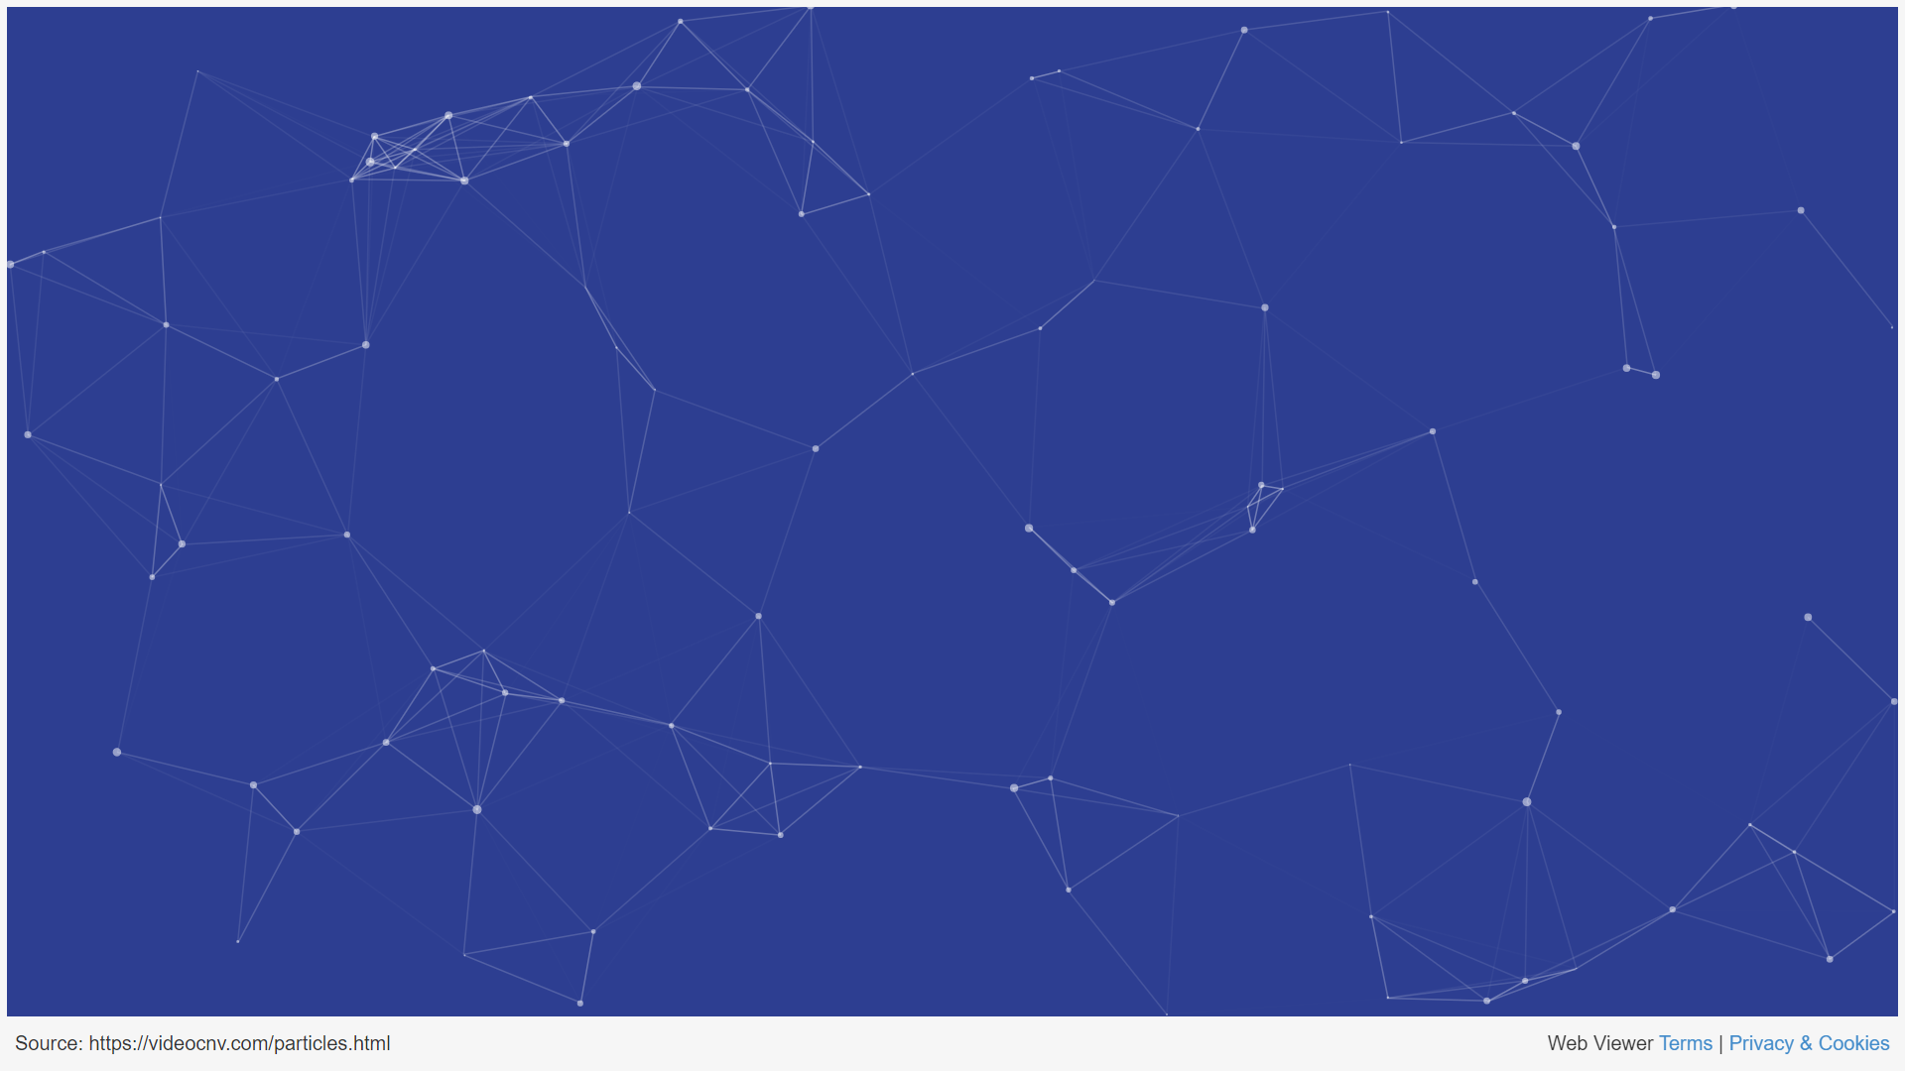
COMMON PATTERNS
- The try-catch-finally pattern
- The try-catch pattern with exception filters
- The exception wrapping pattern
- The exception dispatcher pattern

Slide 6
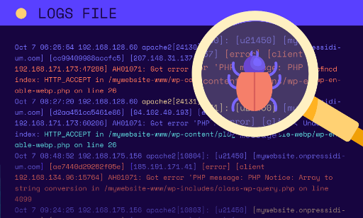
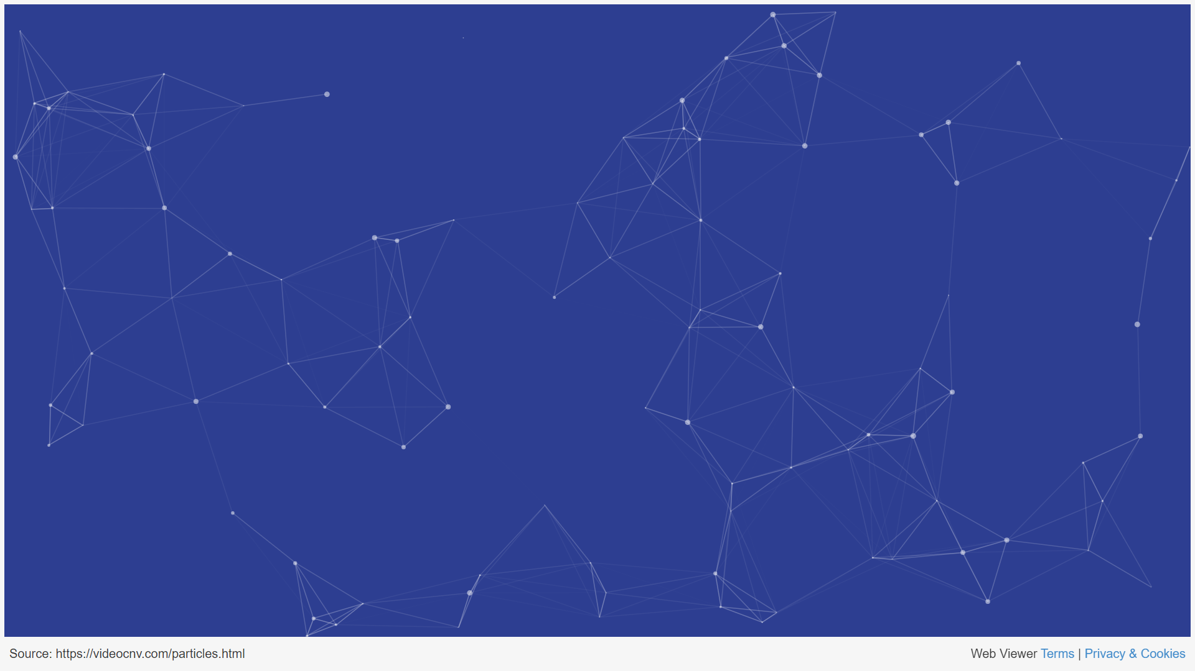
LOGGING
- Debugging and diagnosing issues during development
- Monitoring applications in production environments
- Auditing and tracing user actions for security or compliance purposes
- Analyzing application performance to identify bottlenecks or areas for improvement

Slide 7
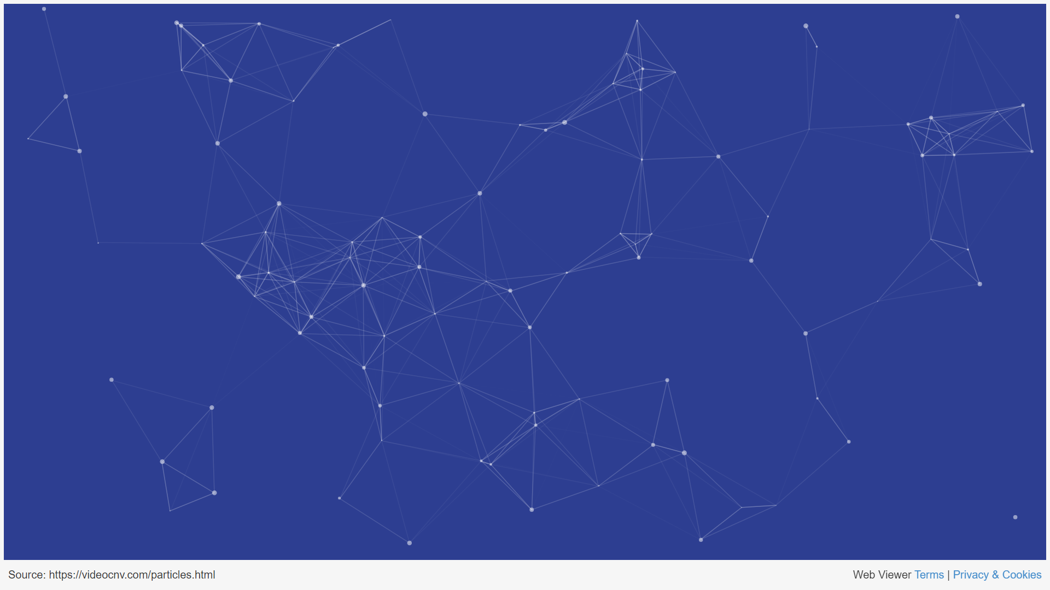
e
Popular Libraries
NLog
log4net
Serilog
- Flexible and easy-to-use logging platform
- Rich feature set, including routing, filtering, and rendering capabilities
- Supports various targets (file, database, email, etc.)
- Good performance and minimal impact on application performance
Website:
https://nlog-project.org/
Initial release in 2006
- Mature and widely-used logging library, but legacy
- Inspired by the popular log4j library for Java
- Extensible and highly configurable
- Supports various appenders (file, database, email, etc.)
Website: https://logging.apache.org/log4net/
Initial release in 2004 (log4j - 2001)
- Structured logging library for .NET
- Designed to make it easy to log complex data structures
- Supports various sinks (file, database, cloud-based services, etc.)
- Integrates with popular logging and monitoring tools (e.g., Elasticsearch, Seq)
Website:
https://serilog.net/
Initial release in 2013

Slide 8


BEST PRACTICES
- Use appropriate logging levels to categorize log messages, adjust based on the environment
- Be mindful of the data you log (e.g., personally identifiable information, passwords, API keys)
- Use try-catch blocks to handle exceptions gracefully
- Log exceptions with appropriate logging levels (e.g., Error or Critical)
- Use consistent and meaningful log message formats
- Include relevant context information (e.g., timestamps, request IDs, user IDs)
- Protect log files from being read publicly

Slide 9
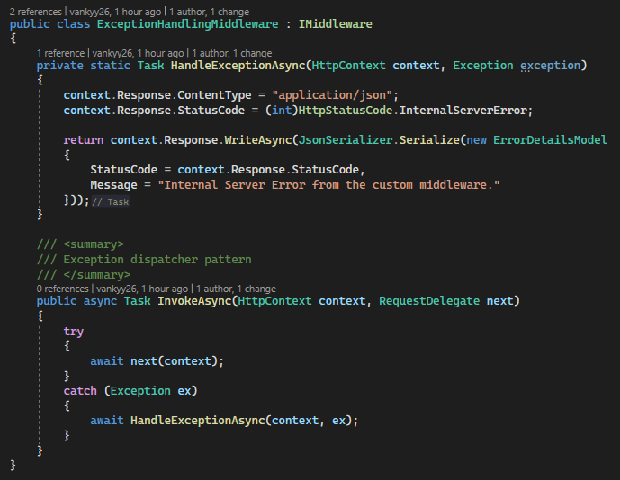
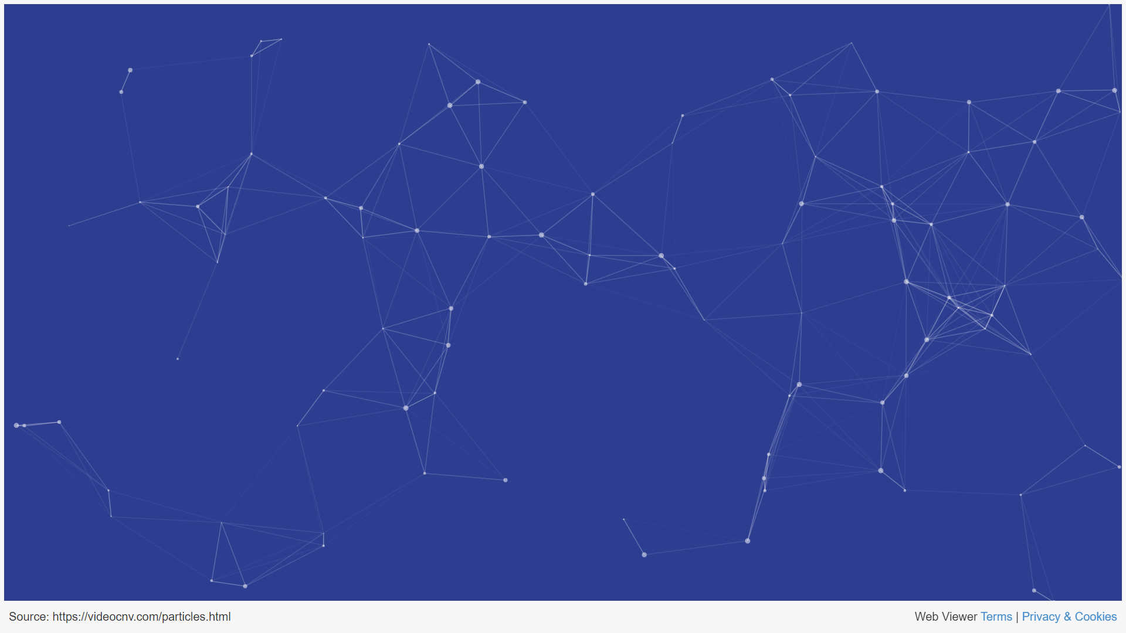
MIDDLEWARE
- Concept in ASP.NET Core applications that represents a series of components in the request pipeline
- Responsible for handling incoming HTTP requests, processing them, and producing an HTTP response, or passing the request to the next middleware component in the pipeline
- Can be used to implement a wide range of functionality, including authentication, caching, routing, logging, exception handling, and more

Slide 10

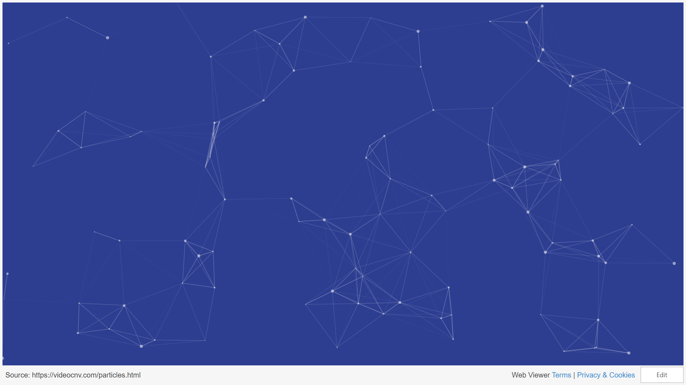
Q&A AND CONCLUSION
- Any questions?
- Concerns or clarify any points that may have been unclear during the presentation?

